Slide 1
RTO Hackathon:
The Soothsayers

Slide 2
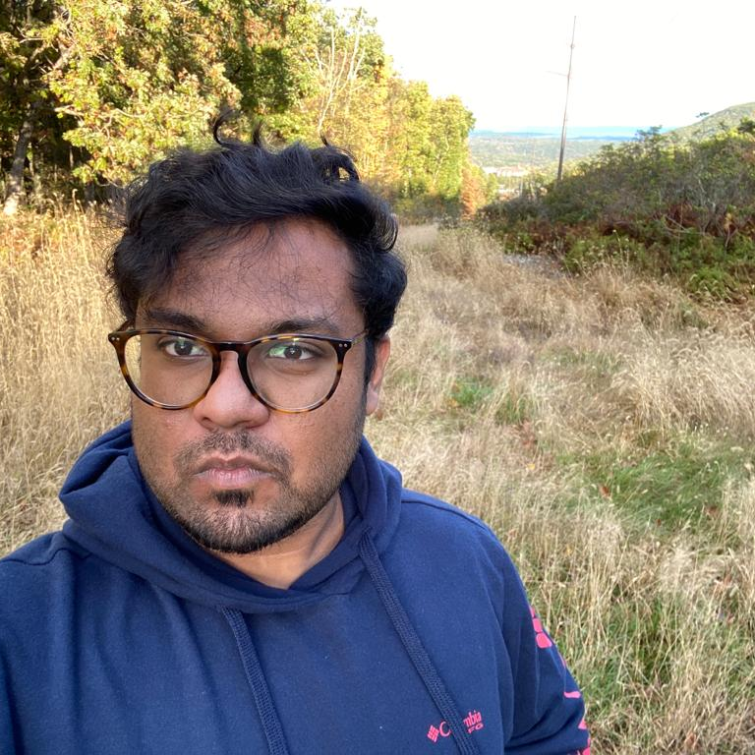




Who is in your team?
We are the soothsayers (a person or a group of people supposed to be able to foresee the future), as the name suggest we are here in this earth to determine your next possible action. We do not use our foresight capabilities to see the future, we leverage technology to foresee the future
Ahmed Ali
He/Him
NJIT, New Jersey
Sumit Singh
He/Him
ISU, Terre Haute
Aman Anand
He/Him
ISU, Terre Haute
Nayana Mahajan
She/Her
Pace, New York
Ravi Singhal
He/Him
PNW, Indiana

Slide 3
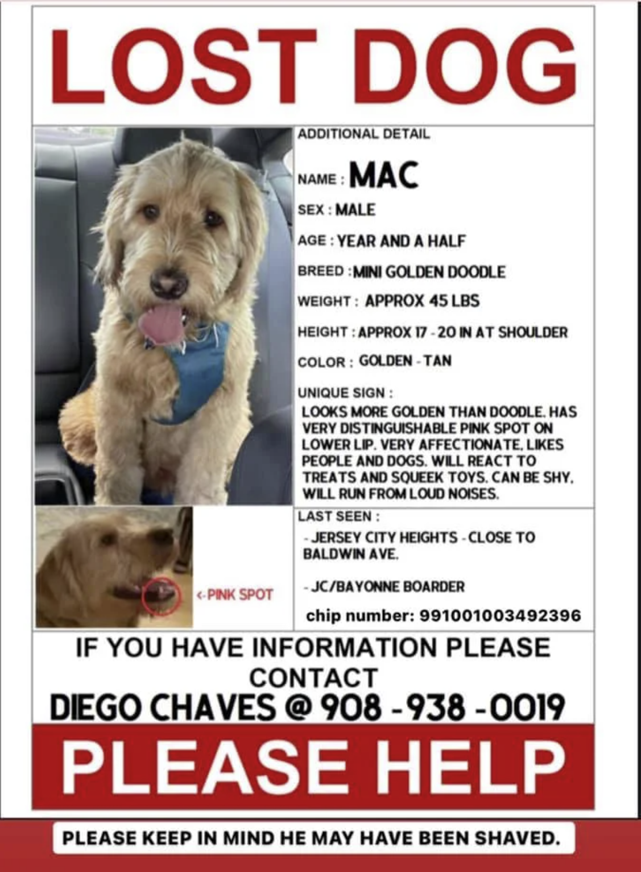
What problem are you solving?
In the US alone, about 70% of the population adopt some kind of animal as their pet and treat them as their family, when an owner loses a pet, they get devastated and have no idea how to find them. It is estimated that about 10 million pets get lost in the US every year.
Problem we are solving
Find the approximate location of the where the animals are found and they lived
Understanding the finder scenario(i.e in or out of the neighbourhood finds, super-finder etc.)
Predict the animal travel distance

Slide 4
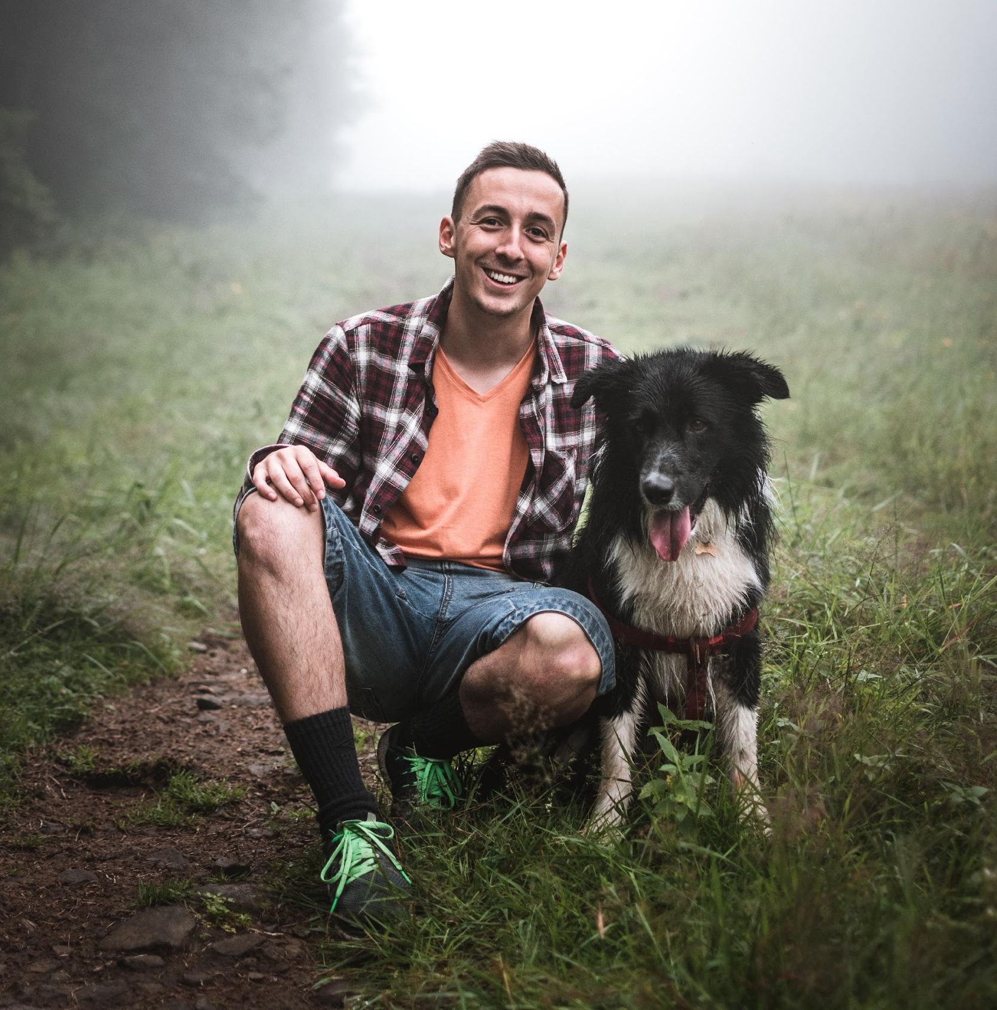

Who is the intended user?
We built our project with keeping in mind the,
Pet owners, and
Shelter management.
Our MVP is a web application which has sections of,
Analytics which we believe will help in shelters decision to organize their resources.
A section for pet owners to estimate where their pet might have travelled and radius of coverage they can use to search for their pets.

Slide 5
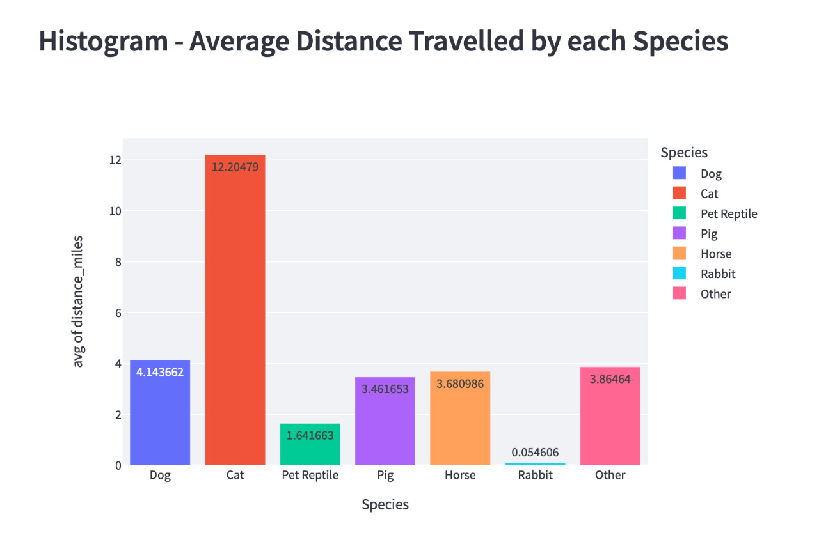
What is your solution?
Our choice of interface is something that is reachable to all demographic, we simplified our UI to web app and mobile application. For this hackathon, we went with building a prototype web application.
Our application has three sections,
Data preview and Statistical Description emulating the data in a tabular form.
Data Analytics dashboard and Graphs visualizing key points from historic outcomes.
Prediction Model providing the nearest shelter that animal could have ended up and the distance animal might have travelled.

Slide 6
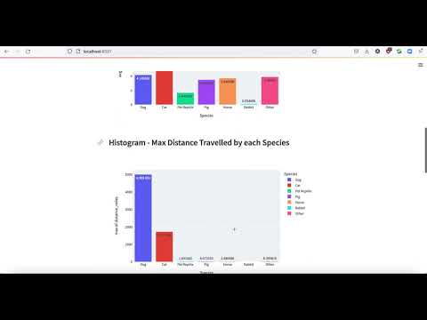
Demo on Streamlit

Slide 7
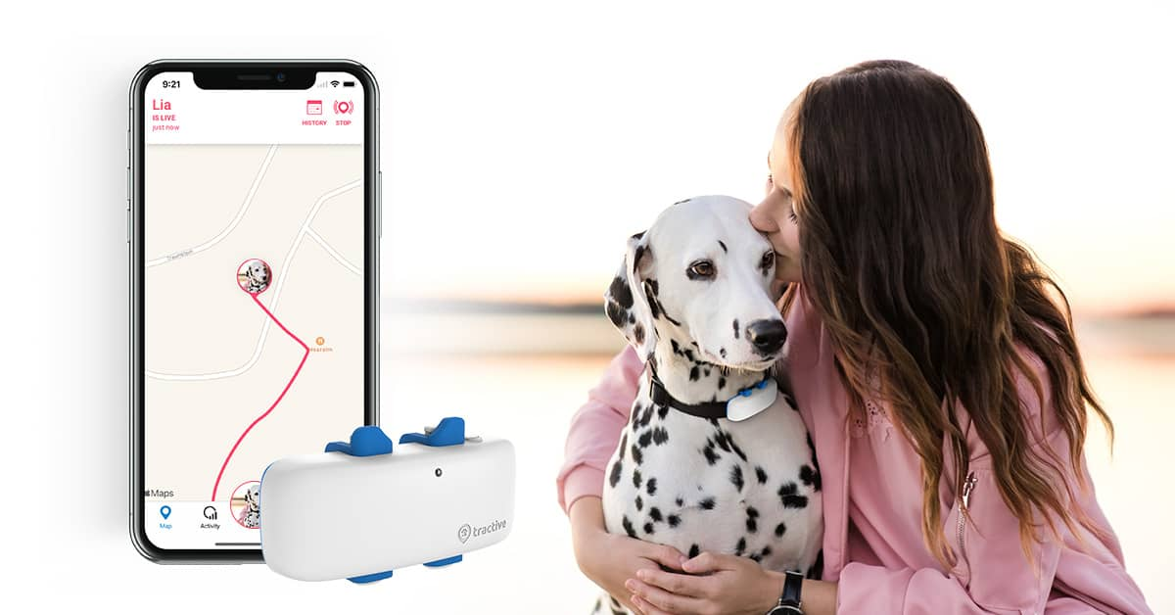
Next Steps
Our next possible step would be to build a cross functional application which is accessible through various devices such as mobile app and web app.
Possible next steps,
Collected more valuable and related data for optimized prediction.
Build a mobile application for Android and IOS users.
Integrate live tracking for pet owners to search for their pet on the go, showing the reduction in distance between them and the approximate distance their pet might have travelled.

Slide 8
Thank you for your attentions
It is now time for Q&A

